Slide 1


K.RAMAKRISHNAN COLLEGE OF TECHNOLOGY (AUTONOMOUS), TRICHY
FEDERATED LEARNING FOR EYE DISEASE PREDICTION
 | PRESENTED BY, KANNIGA SARASWATHY M(811721243035) MADHUMITHA P(811721243026) MONISH VIDYARTHI R(811721243035) SUBALATHA A(811721243035)
GUIDED BY,
Mrs. Nalina Keerthana G
ASSISTANT PROFESSOR/ AI

Slide 2
OBJECTIVE:
To develop a privacy-preserving eye disease prediction system using Federated Learning (FL) that ensures sensitive patient data remains decentralized and secure across multiple sources.
To implement and train a deep learning model using VGG16 architecture, enabling accurate feature extraction and classification of eye diseases from medical imaging data.
Implement ECC encryption to protect the trained model during training and inference.
Aggregate the encrypted models from all devices to obtain a final model that can be used for inference.
To use the ODIR dataset, apply min-max normalization, and split it across clients to simulate decentralized environments.

Slide 3
EXISTING SYSTEM:
Designing and implementing FL models with an emphasis on privacy, tailored specifically for healthcare applications, particularly focusing on disease prediction and patient risk profiling.
Evaluating the performance of the created FL models, involving a comprehensive comparison with traditional centralized ML models, considering factors such as accuracy, privacy preservation, and computational efficiency.
Assessing the real-world implications and potential challenges associated with the deployment of FL models in healthcare settings, along with providing feasible recommendations to circumnavigate identified hurdles.

Slide 4
PROPOSED SYSTEM:
To enhance ocular disease diagnosis, a federated learning framework is implemented to enable collaborative model training across multiple ophthalmology institutions without sharing raw patient data. Preprocessing strategies standardize retinal imaging datasets, ensuring consistency for effective deep learning-based analysis.
A Convolutional Neural Network (CNN) is designed and tailored specifically for detecting ocular diseases such as glaucoma, diabetic retinopathy, and macular degeneration, allowing accurate hierarchical feature extraction while maintaining adaptability within the federated learning paradigm.
The trained model undergoes encryption using Elliptic Curve Cryptography (ECC) before being uploaded to the central server and ensure data security.

Slide 5
LITERATURE SURVEY:
S.NO | PAPER TITLE | AUTHOR NAME | YEAR PUBLISHED | TECHNIQUES USED | MERITS | DEMERITS
1 | Federated Learning in Ocular Imaging: Current Progress and Future Direction | Truong X. Nguyen, An Ran Ran, Xiaoyan Hu, Dawei Yang, | 2022 | Federated Learning (FL), Deep Learning (DL), Distributed Learning, Privacy-Preserving AI | Privacy, , Collaboration, Security, Generalizability | Heterogeneity, Bias, Communication, Security
2 | A Privacy-Preserving Approach Using Deep Learning Models for Diabetic Retinopathy Diagnosis | Jun Chen Ng, Pauline Shan Qing Yeoh, Li Bing, Xiang Wu, Khairunnisa Hasikin, Khin Wee Lai | 2024 | Deep Learning, Convolutional Neural Networks (CNN), Encryption Differential Privacy (DP), Blockchain | Privacy, security, generalizability, automation | Complexity, latenct, optimization, scalability

Slide 6
S.NO | PAPER TITLE | AUTHOR NAME | YEAR PUBLISHED | TECHNIQUES USED | MERITS | DEMERITS
3 | A Detectability Analysis of Retinitis Pigmentosa Using Novel SE-ResNet Based Deep Learning Model and Color Fundus Images | Rubina Rashid, Waqar Aslam, Arif Mehmood, Debora Libertad Ramírez Vargas | 2024 | SE-ResNet Deep Learning, Data Augmentation, Color Fundus Imaging, Feature Extraction | Accuracy, Automation, Efficiency, Feature Extraction | Complexity, Scalability, Generalization, Resource Intensive
4 | DeepDiabetic: An Identification System of Diabetic Eye Diseases Using Deep Neural Networks | Arwa Albelaihi, Dina M. Ibrahim | 2024 | Deep Learning, CNN (EfficientNetB0), RNN Image,Augmentation, Multi-Class Classification | Accuracy, Automation, Generalization, Robustness | Complexity, Computation, Data Imbalance, Scalability

Slide 7
S.NO | PAPER TITLE | AUTHOR NAME | YEAR PUBLISHED | TECHNIQUES USED | MERITS | DEMERITS
5 | Converging Technologies for Health Prediction and Intrusion Detection in Internet of Healthcare Things With Matrix-Valued Neural Coordinated Federated Intelligence | Sarah A. Alzakari, Arindam Sarkar, Mohammad Zubair Khan, Amel Ali Alhussan | 2024 | Federated Learning, Blockchain, Machine Learning, Deep Extreme Machine Learning, Neural Key Synchronization, Intrusion Detection Systems (IDS), | Security, Privacy, Collaboration, Accuracy | Complexity, Computation, Scalability, Integration Challenges

Slide 8
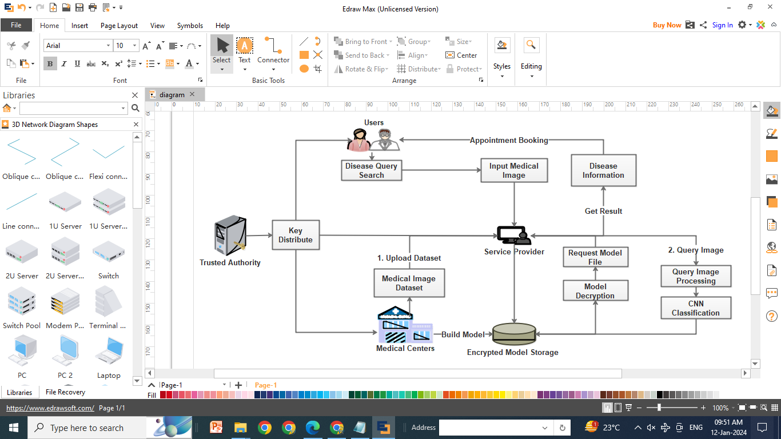
ARCHITECTURAL DIAGRAM:

Slide 9
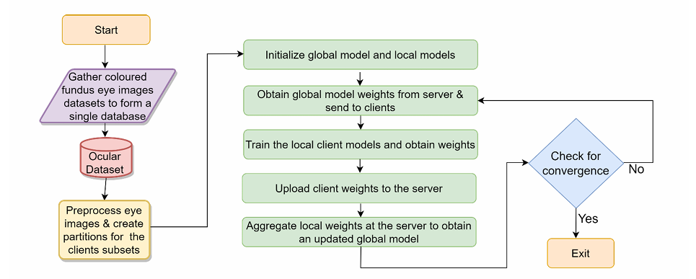
DATA FLOW DIAGRAM:

Slide 10
SYSTEM & SOFTWARE SPECIFICATION:
SYSTEM SPECIFICATION:
SOFTWARE SPECIFICATION:
Processor: Intel i5/i7 or AMD equivalent
RAM: 8GB or higher
GPU: NVIDIA GPU with CUDA support (e.g., GTX 1050/1060 or better)
Storage: 256GB SSD or higher
Operating System: Windows 11.
Model Architecture: MobileNet V2
Clients: 2, 3, 4
Learning Rate: 0.001
Optimizer: Adam
Batch Size: 32
Epochs: 5 (per round)
Communication Rounds: 30

Slide 11
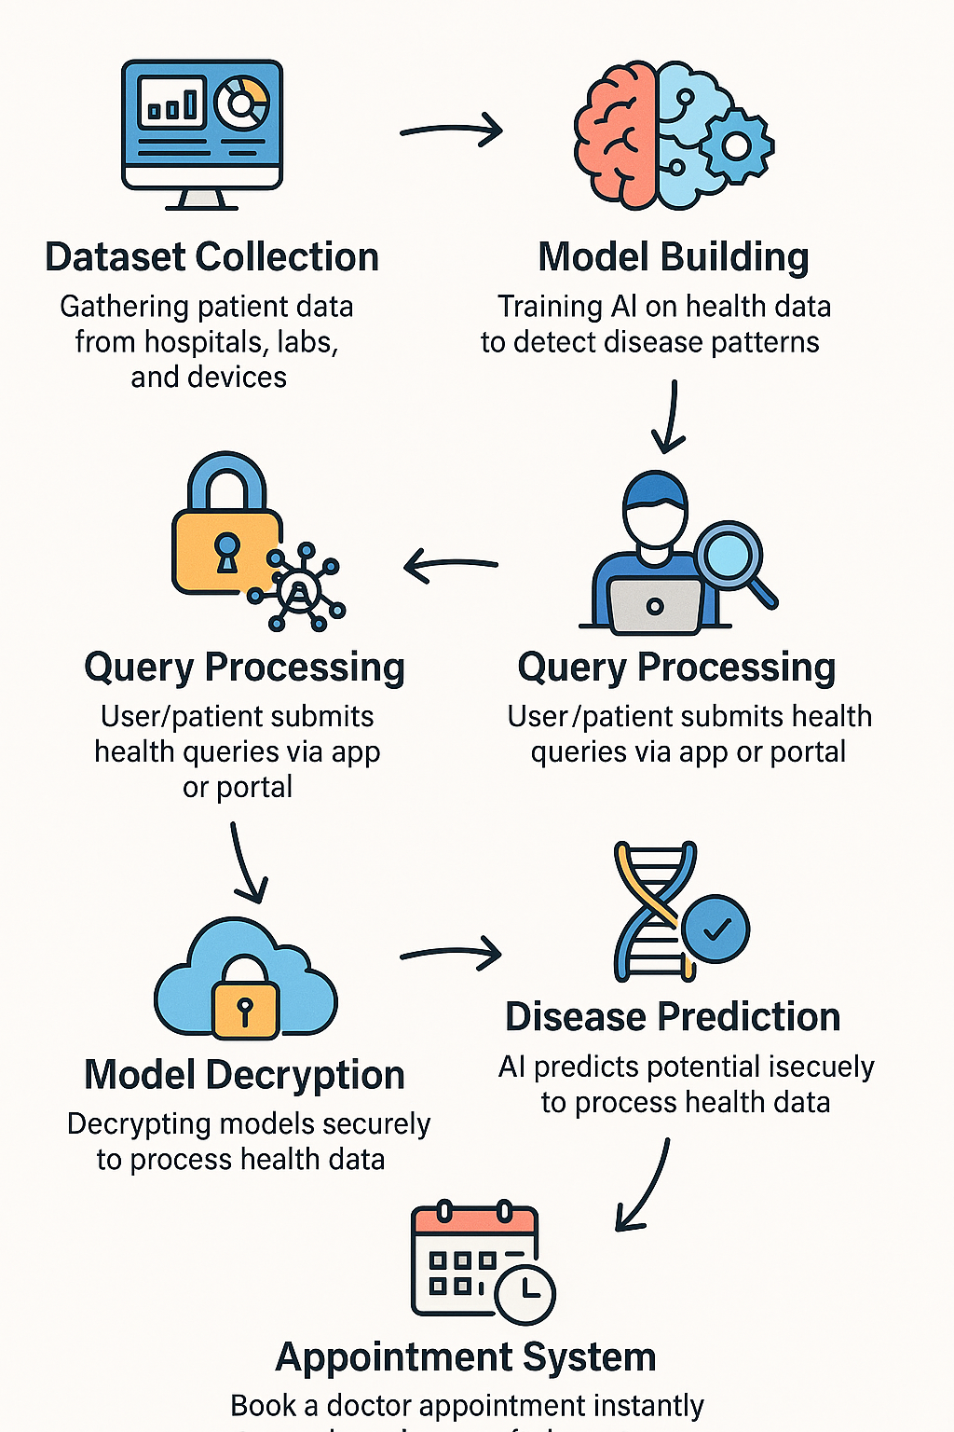
MODULES:
Dataset Collection
Model Building
Encrypted Model Storage
Query Processing
Model Decryption
Disease Prediction
Appointment System

Slide 12
MODULE DESCRIPTION:
DATASET COLLECTION:
The Dataset Collection module serves as the foundation for our project by acquiring 500 medical imaging datasets from multiple healthcare institutions.
This module establishes secure connections with local servers to retrieve data, ensuring compliance with stringent data privacy regulations.
It includes mechanisms for formatting and preprocessing incoming data, ensuring its compatibility with the Convolutional Neural Network (CNN) architecture adopted for disease diagnosis.

Slide 13
The initial stage in machine learning before building a model is data preprocessing. Data
preparation is crucial in increasing data reliability to extract valuable information.
Actual data is frequently unreliable, inaccurate (contains outliers or errors),because of this normalizing describes the discrete range of real-valued numerical properties between 0 and 1.,is being utilized to normalize the data.
The min-max normalization technique is used for data preprocessing Min-Max Normalization
low variance, the ambiguous dataset is structured, and data integrity is maintained using min-max
After preprocessing, the dataset is split into two sections: a training dataset and a testing dataset, with 25% of the dataset used as testing data to assess the proposed model and 75% used to train the model.

Slide 14
2. MODEL BUILDING:
The Model Building module focuses on the construction of robust Convolutional Neural Networks (CNNs) tailored for disease diagnosis in medical imaging.
The ederated learning system comprises a client(s) and a server. The cloud based federated learning server analyses key data types for the target application and trains hyper-parameters like learning rate, number of epochs, activation function, and Adam optimizer.
This module involves the design of a CNN architecture capable of hierarchical feature extraction from medical images.
Training the VGG16 deep neural network model at the second level is required.
Monitoring and logging mechanisms are integrated to track the training progress on each local server.

Slide 15
ALGORITHM:
Every client starts by acquiring updated information and modifying the (Myx) local model parameter, which depends on the global model (Gy), where y is the index for the next iteration. Each client seeks for the optimal situation to minimize the loss.
(a) Initialization: The central server initializes the Global Model with pre-trained weights Wg^0.
Wg^0 ← Initialize
(b) Distribution Phase: The central server distributes the Global Model’s weights Wg^t to selected client devices. Distribute (Wg^t) → Clients
(c) Local Training Phase: For each client device i in parallel, do:
(i) Receive the Global Model’s weights Wg^t.
(ii) Perform local training using the client’s local dataset Di with the received weights to obtain the updated weights WLi,t^(t+1).WLi,t^(t+1) ← Local Train (Di, Wg^t)

Slide 16
(d) Aggregation Phase (FedAvg):
(i) Each client sends their optimised local model weights WLi,t^(t+1), and the size of their dataset ni back to the central server.
Send (WLi,t^(t+1), ni) → Server
(ii) The central server aggregates these updates using the Federated Averaging algorithm, where the number of data points from each client weights the updates.
Wg^(t+1) ← (1/N) ∑_{i=1}^K ni WLi,t^(t+1)
where N = ∑_{i=1}^K ni is the total number of data points across all clients, and K is the number of clients.

Slide 17
3. ENCRYPTED MODEL STORAGE:
The Encrypted Model Storage module addresses security concerns by storing the trained CNN model in an encrypted format, ensuring both secure transmission and storage.
This module leverages Elliptic Curve Cryptography (ECC) for encrypting model parameters, providing a robust encryption mechanism.
Secure protocols are implemented for the storage of encrypted models on the central server, and regular key updates enhance the overall security posture.
Typesofthreats addressed by encryption in FL:
● Gradient leakage attacks: Where adversaries try to reconstruct private data from gradients.
● Eavesdropping:Where attackers intercept data during transmission.
● Modelpoisoning: Malicious clients may inject harmfulupdates to manipulatethe global model

Slide 18
Homomorphic encryptionis used and it allows mathematical operations to be performed on encrypted data without decrypting it. This means that clients can encrypt their model updates before sending them to the server, which can then perform aggregation on the ciphertexts.
Each hospital encrypts its model parameters using HE and sends them to a central server. The server performs federated averaging on the encrypted weights and sends back an encrypted global model.
SMPC model enables multiple parties to jointly compute a function over their inputs while keeping those inputs private. In FL, this can be used to ensure that no single party learns the full model update from others.
DP encryption technique ensures that the removal or addition of a single data point does not significantly affect the outcome of the computation. In FL, noise is added to model updates to obfuscate specific data characteristics

Slide 19
4. QUERY PROCESSING :
The Query Processing module facilitates the submission and processing of queries from healthcare professionals seeking disease predictions.
It encompasses the development of a user-friendly interface for query submission, validation, and preprocessing of incoming queries.
The module is designed to efficiently route queries to the central server.
Then initiating the disease prediction process while maintaining the confidentiality and integrity of the sensitive medical data.

Slide 20
The query begins when a user (a healthcare practitioner, radiologist, or diagnostic technician) inputs data into the system.
This input is typically a high resolution retinal or fundus image, possibly accompanied by metadata like patient age, sex, and previous conditions. In real-world deployments, this data is captured using imaging devices connected to an edge device (e.g., laptop or local server) in a hospitalor clinic.
Instead of sending the entire image to a remote server, the system queries the locally stored global model, which has been updated through previous federated learning cycles.
This model is capable of detecting diseases such as cataracts, diabetic retinopathy, glaucoma, and other ocular conditions. The query is now passed to thepreprocessing pipeline.

Slide 21
5. MODEL DECRYPTION:
The Model Decryption module plays a crucial role in ensuring secure access to the CNN model.
It is responsible for decrypting the model parameters for prediction processing.
Implementing decryption algorithms using ECC keys, the module includes robust authentication and authorization mechanisms to control access.
This module establishes a secure and controlled environment for decrypting the model, safeguarding sensitive information.

Slide 22
The decryption is performed locally on the client side system using pre-shared keys or secure hardware modules like Trusted Platform Modules (TPMs) or Hardware Security Modules (HSMs).
The aggregator encrypts the model with a client’s public key, and only the respective client can decrypt it using its private key. This approach ensures that even if an unauthorized user intercepts the model in transit, it remains unreadable and unusable.
Once decrypted, the model parameters are restored to their usable form—floating-point weight matrices and activation thresholds—which are then loaded into a local execution environment such as TensorFlow Lite, PyTorch Mobile, or ONNX Runtime.
By securely decrypting the model, thismodule prepares it for utilization in disease prediction, maintaining the confidentiality and integrity of sensitive medical information throughout the process.

Slide 23
6. DISEASE PREDICTION:
The Disease Prediction module is the core component responsible for predicting eye diseases based on input queries using the decrypted CNN model and VGC architecture.
Integrating the decrypted model enables real-time predictions, providing confidence scores and detailed diagnostic information.
The module ensures that results are communicated securely to the requesting healthcare professionals, maintaining the privacy and confidentiality of patient data.

Slide 24
This module is the central system responsible for analyzing user input (e.g., retinal images or medical records) to predict eye diseases.
It uses decrypted deep learning models-specifically CNN (Convolutional Neural Networks) and VGG architecture-to perform classification and diagnosis.
VGG (especially VGG16 or VGG19) uses a deep stack of convolutional layers with small 3x3 filters to extract fine-grained spatial features from retinal or eye scan images.
This helps in identifying minute patterns like blood vessel anomalies, hemorrhages, or lesions typical in diseases like diabetic retinopathy or glaucoma.
Early layers detect simple features (edges, colors), while deeper layers learn complex patterns (optic disc shapes, texture distortions).
This hierarchy enables the model to differentiate between healthy and diseased eyes with high precision.

Slide 25
APPOINTMENT SYSTEM:
Facilitating seamless coordination between disease predictions and patient care.
The Appointment System module allows healthcare professionals to schedule follow-up appointments based on the outcomes of the disease prediction module.
Integrating with the prediction module, it provides a user-friendly interface for appointment, thereby enhancing overall patient care coordination.
The Appointment Booking Module is developed to enhance healthcare accessibility by enabling patients to schedule eye checkups, follow-up consultations, or emergency visits directly through a digital interface.

Slide 26
The system supports both manual and automated booking. For high-risk cases (e.g.,advanced diabetic retinopathy), the module can trigger an auto-scheduling feature,notifying both the patient and the doctor of an urgent appointment suggestion.
The patient receives a diagnostic report with a risk level (e.g., mild, moderate, severe).Based on this risk level, the system recommends doctors who specialize in the relevant condition.
Priority slots are automatically opened for high-risk patients to ensure fast-track care!
The scheduling engine of the module is supported by rule-based and Aldriven algorithms that handle:
Time slot optimization (avoiding overlaps or overbooking)
Load balancing across doctors in the same facility
Geolocation-based filtering of nearby clinics
Priority queues for emergency or high-risk cases

Slide 28
ADVANTAGES
Enhanced security with real-time alerts.
Better user control and flexibility through remote monitoring.
Reduced false alarms with intelligent motion and object detection.
Automated theft detection by comparing before and after footage.

Slide 29
APPLICATION
Automated Ocular Disease Diagnosis
Privacy-Preserving Medical Imaging Analysis
Secure Model Deployment
Clinical Decision Support
Predictive Patient Risk Profiling
Remote Consultation & Appointment Booking
Medical Research & Continuous Learning

Slide 30
CONCLUSION:
Cataract, diabetic retinopahty, glaucoma is a major ocular disease that worsens over time, requiring early detection and protection of sensitive patient data. Our project introduces a privacy-preserving approach using federated learning (FL) combined with the VGG16 deep neural network to diagnose cataracts effectively without compromising patient confidentiality. The model utilizes data from the ODIR database containing 300 records. A min-max normalization technique was applied to extract key features. With two clients involved, the dataset was split accordingly, and the model was trained separately on each client. The final aggregated accuracy from both clients reached 95.28%, with Client 1 achieving a best accuracy of 95.0% in round 3, and Client 2 reaching 96.0% in round 2. The average ROC curve value of 0.985 further highlights the method's high performance. our system also proved to be efficient in terms of training time and storage, making it well-suited for medical devices with limited resources. our mechanism of FL allowed simultaneous model training across multiple locations, preserving privacy while minimizing computational load.

Slide 31
REFERENCE:
[1] Qayyum, Adnan, et al. "Secure and robust machine learning for healthcare: A survey." IEEE Reviews in Biomedical Engineering 14 (2020): 156-180.
[2] Masood, Fawad, et al. "A lightweight chaos-based medical image encryption scheme using random shuffling and XOR operations." Wireless Personal Communications 127.2 (2022): 1405-1432.
[3] Hasan, Mohammad Kamrul, et al. "Lightweight encryption technique to enhance medical image security on internet of medical things applications." IEEE Access 9 (2021): 47731-47742.
[4] Aparna, Puvvadi, and Polurie Venkata Vijay Kishore. "Biometric‐based efficient medical image watermarking in E‐healthcare application." IET Image Processing 13.3 (2019): 421-428.
[5] Kamal, Sara T., et al. "A new image encryption algorithm for grey and color medical images." IEEE Access 9 (2021): 37855-37865.

Slide 32
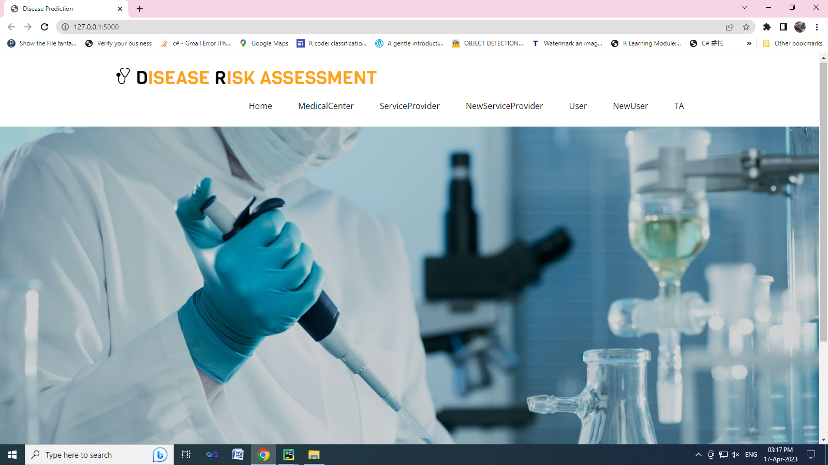
EXPERIMENTAL RESULTS

Slide 33
THANK YOU !!!!

